Slide 1
MAST6100: Machine Learning and Deep Learning Final Project
Sarah Lee Lwp

Slide 2
Table of contents
01
02
03
04
05
Background and Motivation
Research Question
Overview of Data
Methodology
Models

Slide 3
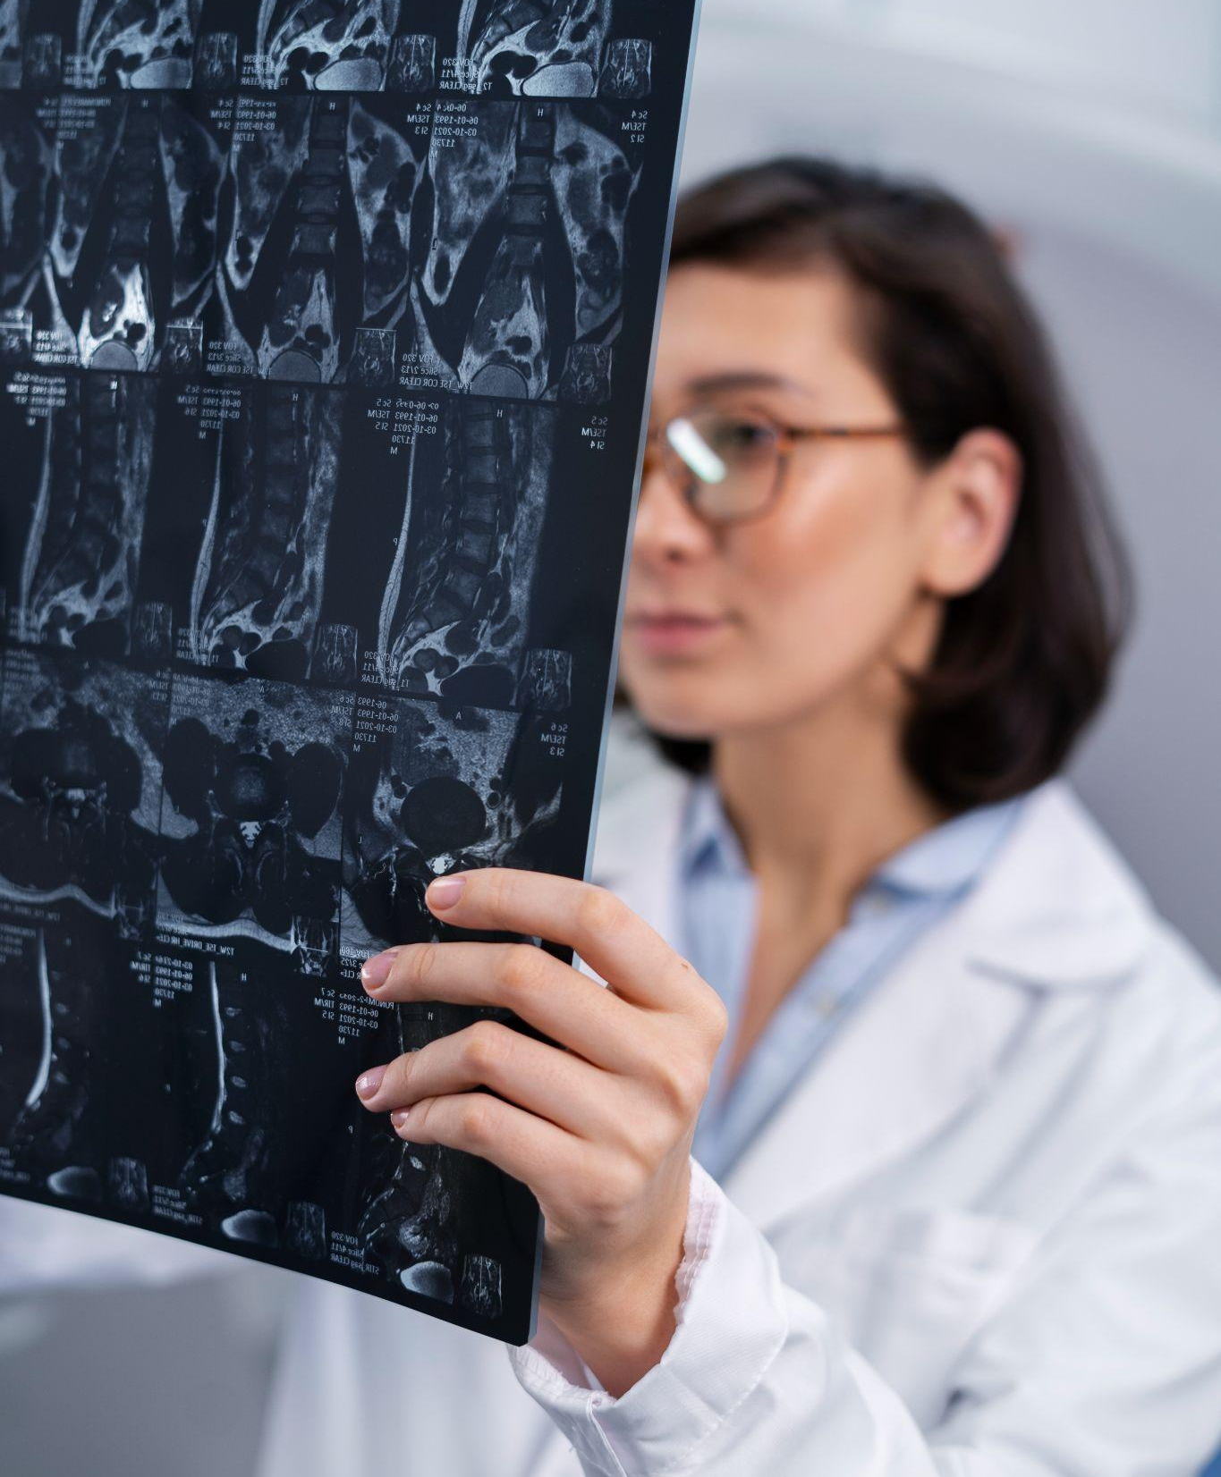
Background and Motivation
01
Hospitals worldwide are facing increasing pressure on resources
Key challenges:
  Overcrowding
  Extended waiting times
  Rising healthcare costs
Major issues in current hospital admissions:
  Avoidable/unnecessary admissions
  Delayed admissions for urgent care

Slide 4
Research Question
02
What are the factors that affects the type of hospital admissions?

Slide 5
Overview of Data
03
Data was taken from kaggle.com
Response variable: Hospital admission types
Independent variables:
  Age (Years)
  Gender
  Blood type
  Medical Condition
  Insurance Provider
  Billing Amount
  Room Number
  Medication
  Test Results
Limitations of data:
  Data coverage - Data covers only admitted patients
  Test results - Type of medical test conducted is unknown

Slide 6
Methodology
04
Data Cleaning and Quality Checking
Exploratory Data Analysis (EDA)
Variable Selection and Regression
Classification and Deep Learning

Slide 7
Models
05
K-Nearest Neighbours (KNN) Classification
Multinomial Logistic Regression
Neural Network
Random Forest Classification
Linear Discriminant Analysis (LDA) Classification

Slide 8
Thank you!

